Slide 1
Drexel Game Devs
Meet A.D.A.M.!

Slide 2
Team Members and Roles
Joseph Lipinski - Project Lead, Level Designer
Sarah Kushner - Game Artist
Zachary Lopez - Technical Lead
Matthew Freihofer - Physics Programmer
Patrick Nwanah - A.I. Programmer
Cory Cellucci - Programmer

Slide 3
Problem to be addressed
Bored? Do you have nothing to do? Especially not reading assignments or homework assignments.
Instead of being bored, why not play our game!

Slide 4
What to expect from our game?
Procedural level generation
A.I. behavior responsive to player’s position
Physics will affect enemies and player alike
2D platforming and side-scrolling shooting
8-bit art style
Scoring system
Notes:
Speaker Order per bullet: Joe, Patrick, Fry, Cory, Sarah, Zac

Slide 5
What We Are Using to Make it all happen
Pygame 3.2
Python 3.2
Visual Studio

Slide 6
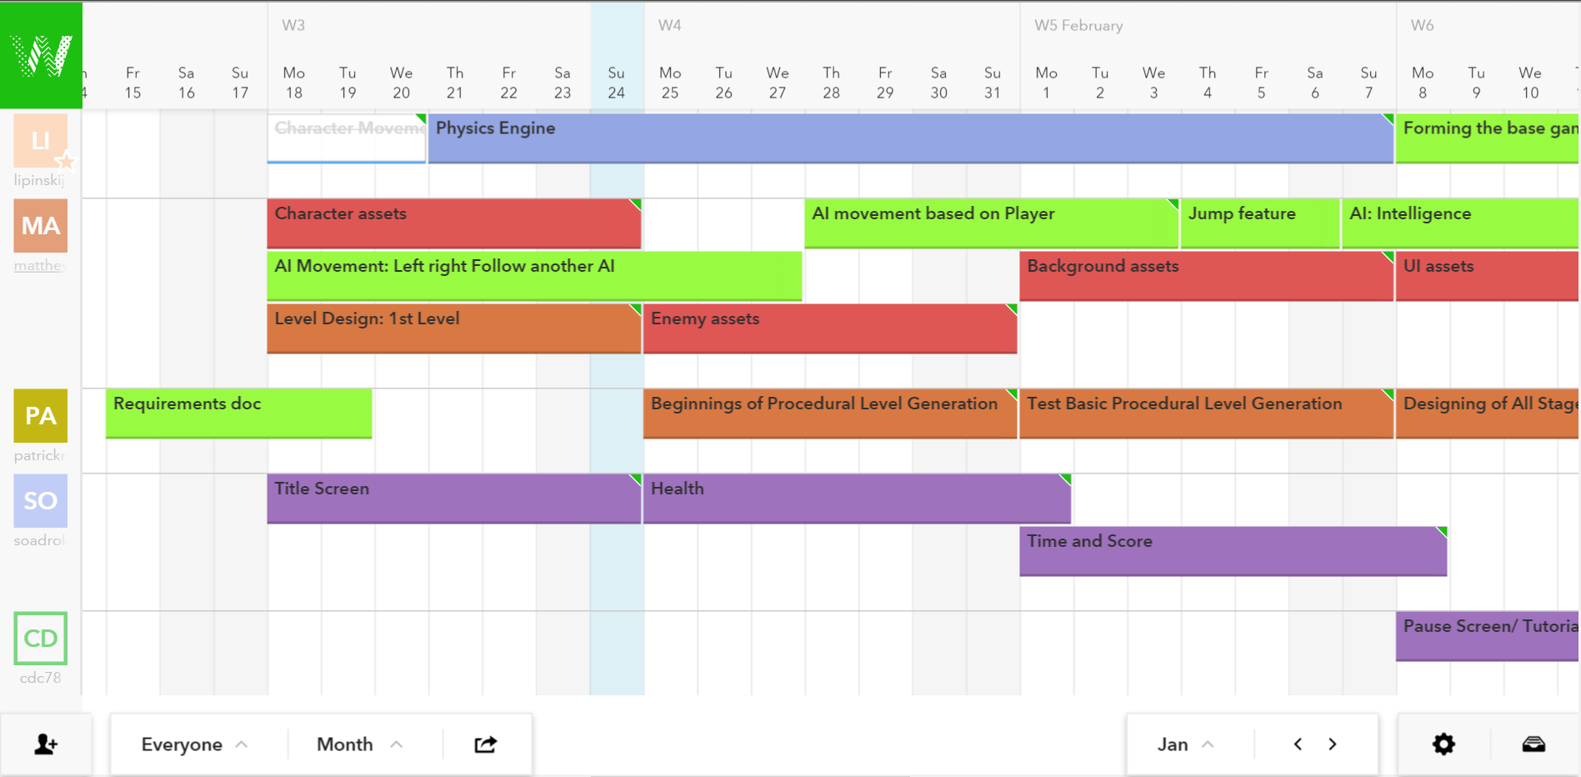

Slide 7
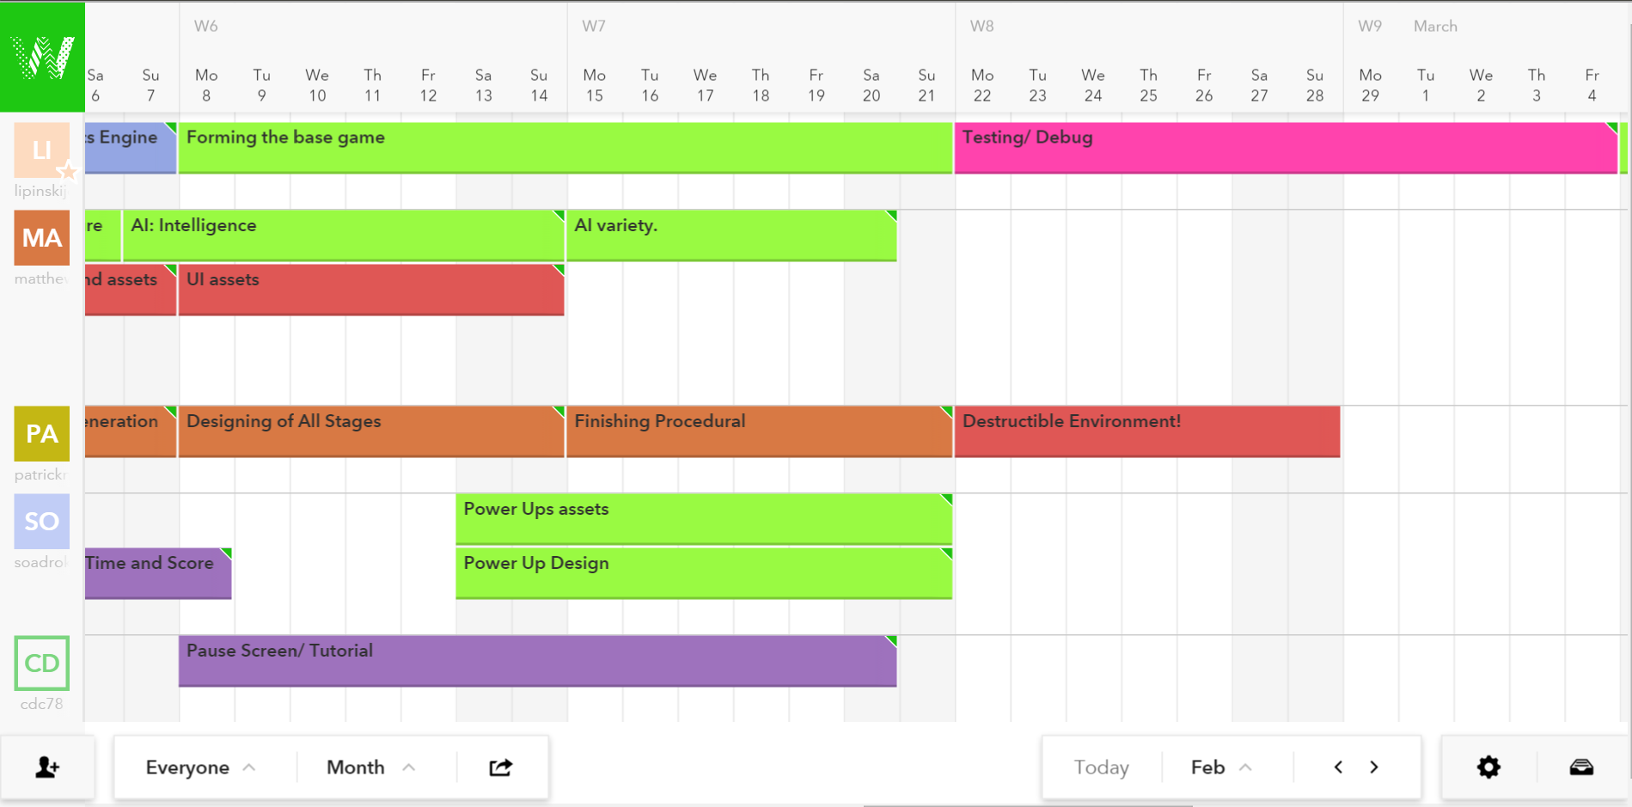

Slide 8
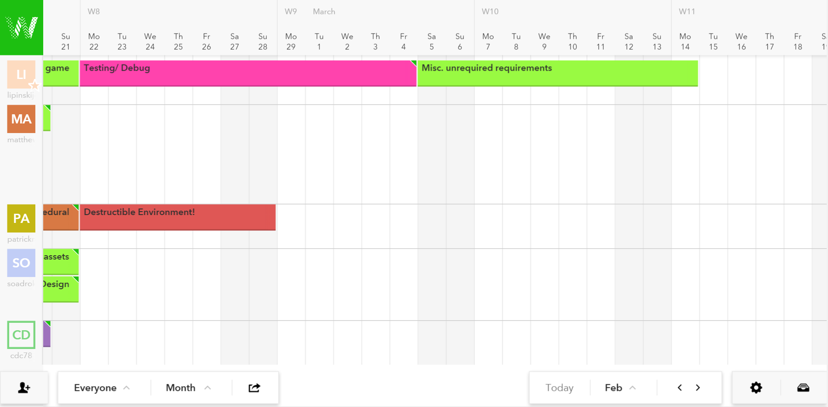

Slide 9
Demo!

